Slide 1
SIMPLE CALCULATOR
Presented by:
Praveen Magadum

Slide 2
Content
Project overview
Flow chart
Component used
Working
Application and Future scope
Conclusion
Reference

Slide 3
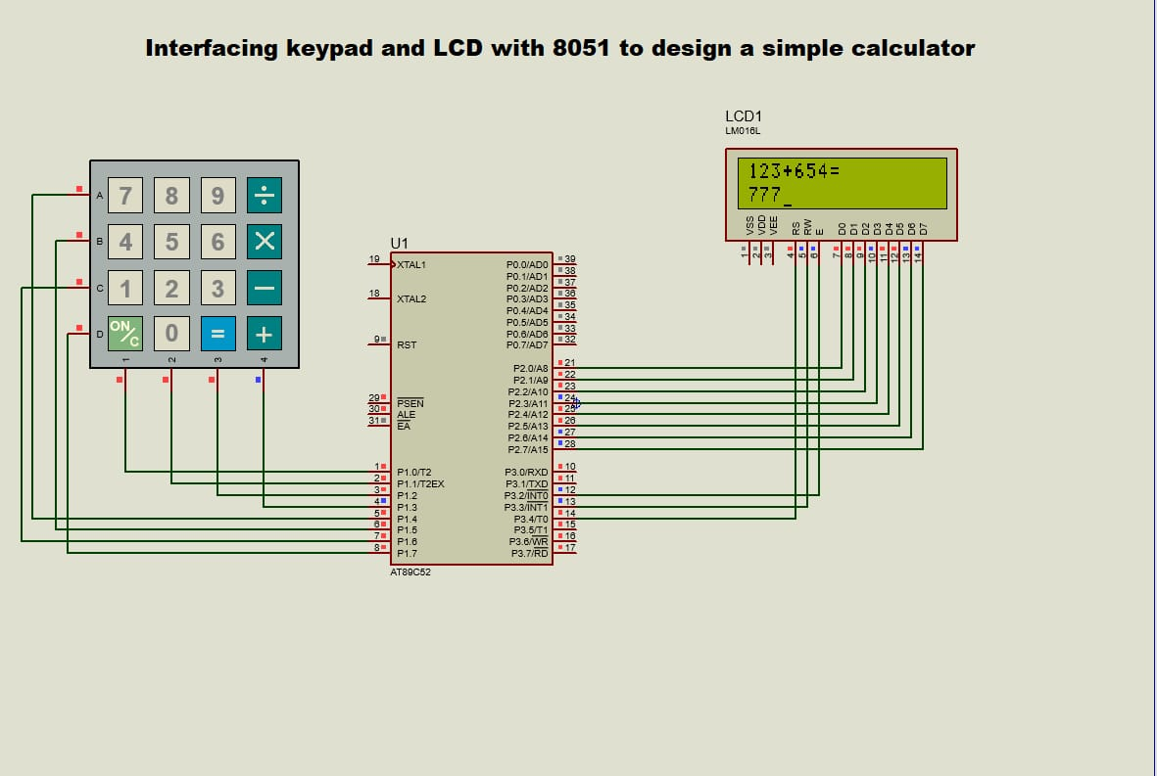
Project Overview
It uses 4*4 keypad matrix to take input number or operation sign, controller processes the data and send output to port two where LCD is connected.

Slide 4
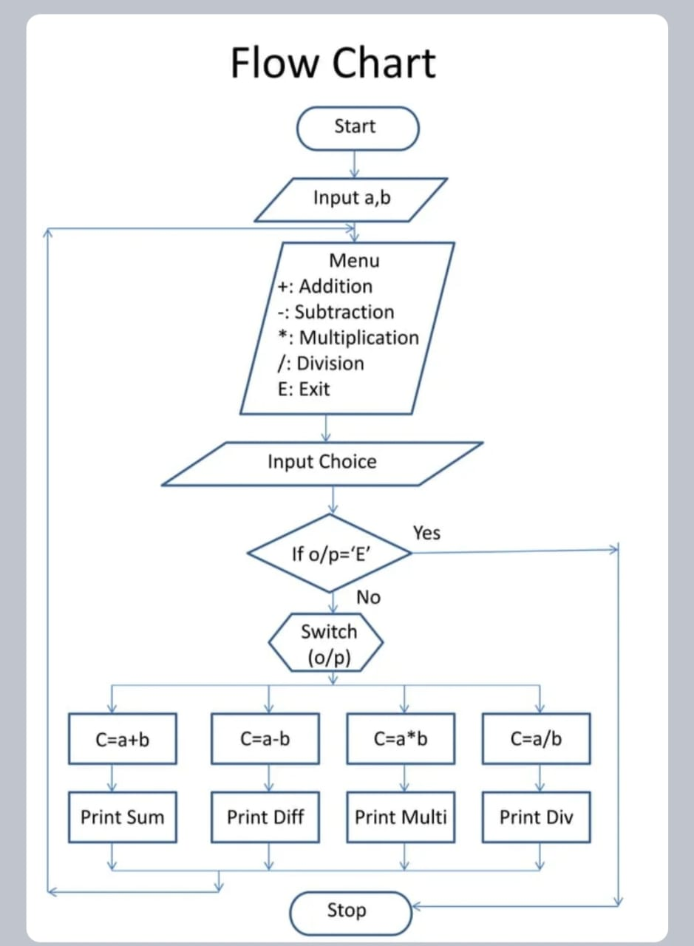

Slide 5
Component Used
4*4 matrix keypad
Microcontroller AT89C51
16*2 Liquid Crystal Display (LCD)

Slide 6
Working
A simple calculator takes input from a keypad and displays the answer on 16*2 LCD display.
To build a simple calculator that adds and subtracts four stages are needed.
The first stage takes the serial input of a number from a keyboard, converts the number into hex, and stores it into memory.
The second stage also takes serial input from the keypad only this time it is an operation key.
The third stage repeats the first stage by storing a second hex number to memory.
Finally the fourth stage is performed when the equal sign is pressed.

Slide 7
Application and Future Scope
A calculator is a small electronic device used to perform various arithmetic operations like addition, subtraction, multiplication and division.
It makes our calculations easier and faster.
It is a portable device that can use anywhere to perform simple mathematical operations.
Human initiative or Manual Labour may be significantly minimized.
Large operations that are conducted manually can be completed in a matter of seconds.

Slide 8
Conclusion
Used to calculate algebraic calculations, using microcontroller interfaced with a LCD can perform various operation which are highly accurate.
Thus this project is very suitable for small scale as well as medium scale calculation.

Slide 9
Reference
https://www.engineersgarage.com/calcultor-with-8051-in-c-language/

Slide 10
THANK YOU

